Slide 1

FACTORS INFLUENCING CO2 EMISSIONS
Presented by
Group – 3; Rukmani Thiruppathi, Aditya Yadlapalli, Ajinkya Ravindra Rane, Aditya Lakshmi Narayanan, Pratik Singh Chauhan

Slide 2

Agenda
Data source and Objectives
Situation
Current CO2 levels and why is CO2 a major concern
Which countries are the top contributors
What are the major sources of CO2 emissions
Regression model
What are the top factors that affect CO2 emissions
How are they changing over years
How are these factors different for developed and developing countries

Slide 3
DATASOURCE AND OBJECTIVES
The Presentation is submitted as part of research project done as a part of the course ‘Business Analytics with R’ - BUAN 6320.
Public domain data available on Kaggle is being for the analysis. It can be accessed from the link https://www.kaggle.com/worldbank/world-development-indicators
The World Development Indicators from the World Bank contains about 800 annual indicators of economic development from over 190 countries across 5 decades. These indicators are spread across economy, energy consumption, birth/death rate, literacy rate, pollutants, trade, logistics and several others.
These metrics are used to show pollution levels across countries, from which models are built to identify factors contributing to Co2 emissions.

Slide 4


Current pollution Levels around the world and Why is CO2 seen as a major greenhouse gas?
“Air pollution causes more than 3 million deaths every year. “
In the U.S., air pollution causes as many as 50,000 deaths per year and costs as much as $40 billion a year in health care and lost productivity.
In China, over 1million die every year because of air pollution.
Similarly in India, over 600,000 die each year because of air pollution.
According to the ‘Proceedings of the National Academy of the Sciences’; “Among all greenhouse gases, CO2 is a major gas that sticks around in the atmosphere for decades to centuries, wreaking climate havoc. Hence CO2 is the most important factor that contributes to global warming”.

Slide 5
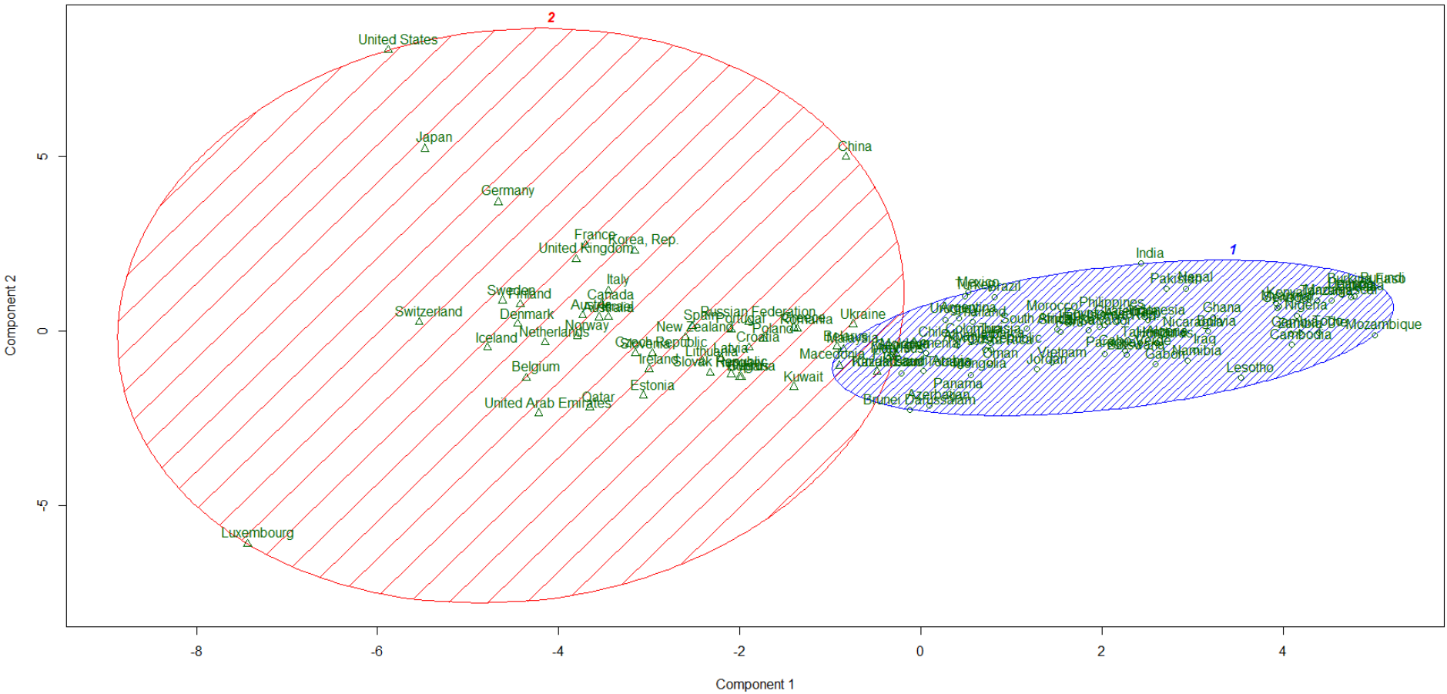
Countries classified as developed and developing.
Classification based on K-means clustering with k=2, Economic Variables considered for the Year of 2011.

Slide 6
Classification among G20
Developed Countries
Australia
Canada
China
France
Germany
Italy
Japan
Russia
Saudi Arabia
United Kingdom
United States
South Korea
Developing Countries
Argentina
Brazil
India
Indonesia
Mexico
South Africa
Turkey

Slide 7
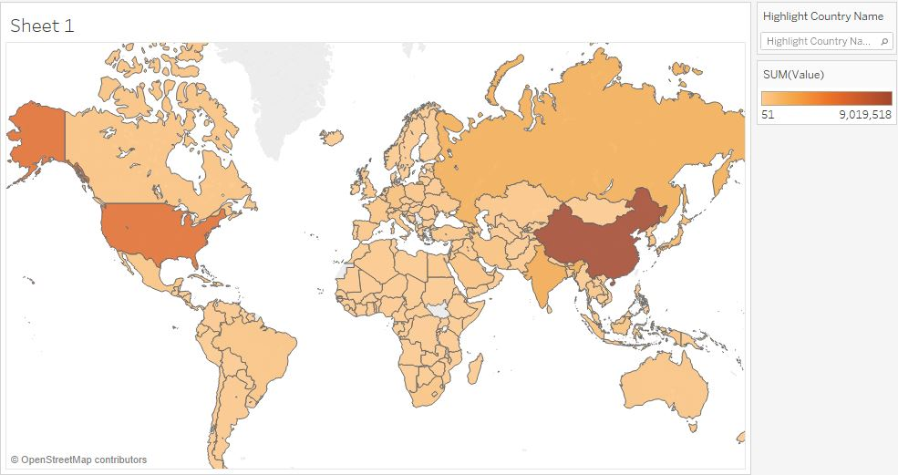
Heat Map showing levels of Co2 in different countries.
China, USA and India top 3 contributors. Mix of developing and developed nations
China
India
USA
Russia
Japan
Germany
South Korea
Iran
Indonesia
Saudi Arabia
Data considered : Year of 2011. Top 10 contributors listed. Developed countries highlihhted in blue

Slide 8
CO2 emissions from G20 countries over past 5 decades

Slide 9
Liquid fuel and electricity production sector top contributors to emissions. Emissions growing from power and Transport sectors, which indicate infrastructure development

Slide 10
Hydroelectricity is the major renewable source of electricity production which helps in reducing CO2 emission
Output of panel data regression: Fixed Effects Model
The below numbers indicate by how much each factor affects CO2 emission (kt) when electricity production through the sources mentioned below increases by 1 %
Source of electricity production | Effect on CO2 emission
Hydroelectricity | -582
Renewable energy source, excluding hydroelectricity | -202
Nuclear energy | 790
Oil source | 519
“ Electricity and heat generation is the economic sector that produces the largest amount of man-made carbon dioxide emissions. “

Slide 11

Delving into the regression model.

Slide 12
Decade-wise impact of significant independent variables on CO2 emission
Decade 1966 to 1975
Total Population
Electricity production from coal sources
Fossil fuel energy consumption
Decade 1976 to 1985
Total mineral reserves
Electricity production from hydro electric
Electricity production from nuclear sources
Arable land
Decade 1986 to 1995
Total Population
Total mineral reserves
GDP per capita (current US$)
Employment in industry
Electricity production from hydroelectric
Decade 1996 to 2005
Total Population
Total mineral reserves
GDP per capita (current US$)
Employment in industry
Decade 2006 to 2015
Total Population
Total mineral reserves
GDP per capita (current US$)
Employment in industry
Electricity production from oil sources
Adj Rsquare in the range of 70- 80% for all models. All models significant

Slide 13
Trend of contribution of significant variables to C02 emissions across the five decades
Contribution of Population in CO2 emission was almost consistent through the start of decade 1986 till end of decade 2005 but it incremented two fold as compared to its contribution in decade 1966 to 1976.
Similarly ,from the start of decade 1976 till end of decade 2005, the contribution of total reserves to CO2 emission has also decreased prominently.
Employment in industry leading to increase in CO2 emission came into significance from 1986 decade onwards. During the decades 1986 to 1995 and 1996 to 2005 their contribution to CO2 emission was similar
and then later on its contribution increased by two times.

Slide 14
Factors affecting CO2 emission in Developed and Developing Countries
Developed Countries
Total Population
Air Transport Passengers Carried
Electricity produced from Oil Sources
Total Employment in Industry
Developing Countries
Total Population
Total Reserves
Total Electricity Consumption(KWh per capita)
Electricity production from Nuclear Sources
Total Arable Land

Slide 15

Data source and Objectives
Situation
Current CO2 levels and why is CO2 a major concern
Which countries are the top contributors
What are the major sources of CO2 emissions
Regression model
What are the top factors that affect CO2 emissions
How are they changing over years
How are these factors different for developed and developing countries
It sticks around and should be a long term focus
China, USA, India and Russia are top 4. Contains both developing and developed countries.
Summing up
Manufacturing Industries and vehicular emissions
Population, industrialization, electricity consumption and mineral/oil wealth of a country
Contribution from industrialization is increasing while total impact of mineral reserves is decreasing.
Emissions from Developed are more from transportation and industrialization where as reserves and population still play dominant role in developing nations

Slide 16

Questions ?

Slide 17
Appendix

Slide 18
Missing Value Treatment
The dataset consists of 800 indicators out of which 18 were chosen for this analysis. The variables have been chosen in such a way that minimum correlation exists between the variables so as to obtain an accurate model.
Almost all the variables over the 5 decades consisted of a lot of missing values. Many columns were missing more than 50% of the data.
We made a judgement call as to impute variables which had less than 50% of missing data. We set the threshold high as some of the variables were significant to obtain an accurate analysis.
‘Mice’ function( CART method) was used to impute missing values. Even though all the variables in consideration had numeric values, imputing missing values with mean or mode would be a rote approach.

Slide 19
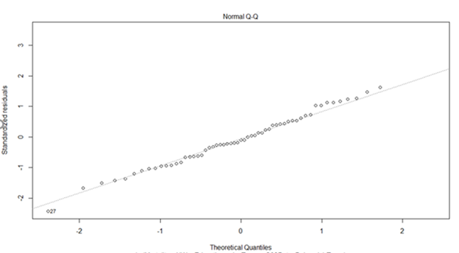
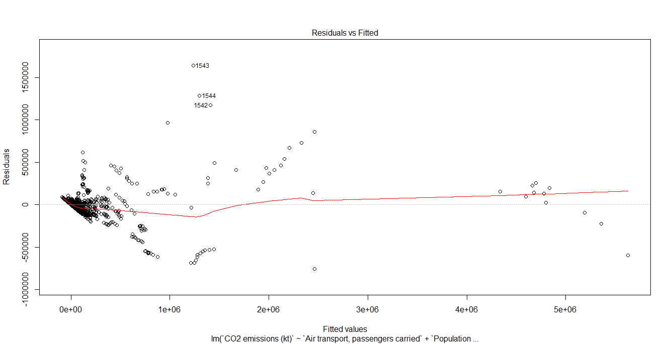
Normality:
Dependent variable CO2 emission (kt) was considerably skewed and hence used logarithmic transformations.
Below are the graphs obtained after normalization:
Homoscedasticity:
Since there is no pattern, we can conclude that the variance of error terms are similar.

Slide 20
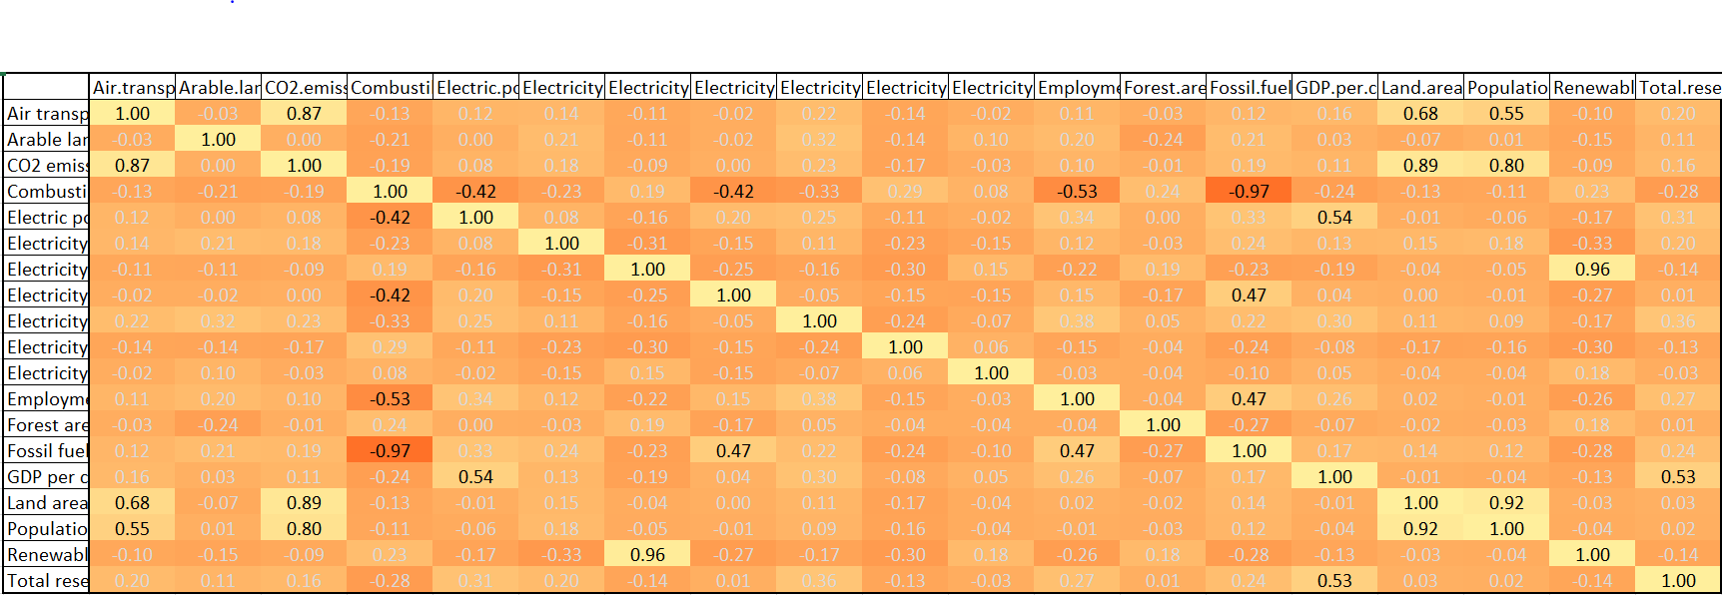
Bivariate Analysis:
Variables which were highly correlated were removed from model to avoid multicollinearity.

Slide 21
Sample outputs
Sample output of one decade
Call:
lm(formula = `CO2 emissions (kt)` ~ `Air transport, passengers carried` +
`Population, total` + `Electricity production from coal sources (% of total)` +
`Fossil fuel energy consumption (% of total)`, data = mice_output1)
Residuals:
Min 1Q Median 3Q Max
-295235 -11035 -1146 13111 230070
Coefficients:
Estimate Std. Error t value Pr(>|t|)
(Intercept) -2.822e+04 8.240e+03 -3.425 0.000754 ***
`Air transport, passengers carried` 2.087e-02 2.474e-04 84.359 < 2e-16 ***
`Population, total` 7.464e-04 4.817e-05 15.494 < 2e-16 ***
`Electricity production from coal sources (% of total)` 5.094e+02 1.749e+02 2.913 0.004017 **
`Fossil fuel energy consumption (% of total)` 3.088e+02 1.082e+02 2.853 0.004809 **
---
Signif. codes: 0 ‘***’ 0.001 ‘**’ 0.01 ‘*’ 0.05 ‘.’ 0.1 ‘ ’ 1
Residual standard error: 48660 on 188 degrees of freedom
Multiple R-squared: 0.8087, Adjusted R-squared: 0.7983
F-statistic: 2164 on 4 and 188 DF, p-value: < 2.2e-16

